Slide 1
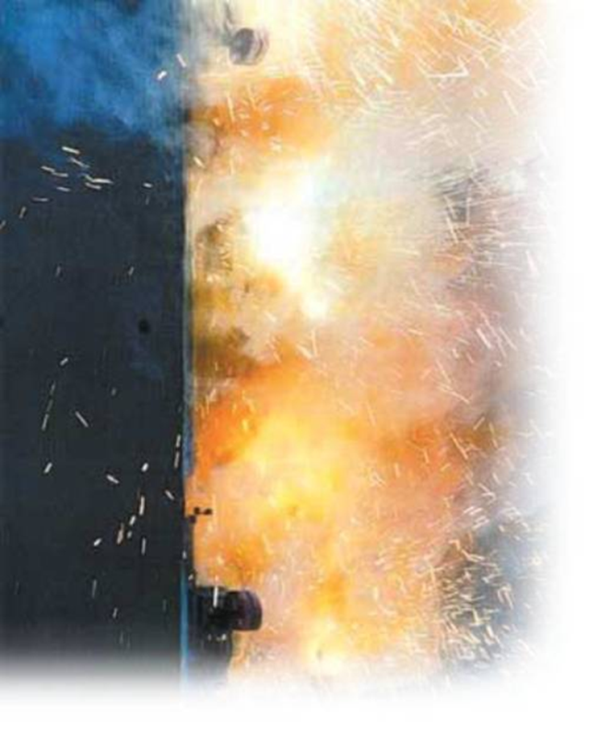
2017 NEC Revisions
2000A
Presented to: IEEE-IAS (Atlanta)
Presented by:
Michael D. Seal, P.E.
400A
1200A
1600A

Slide 2
2014 NEC Article 240.87
240.87 Arc Energy Reduction. Where the highest continuous current trip setting for which the actual overcurrent device installed in a circuit breaker is rated or can be adjusted is 1200 A or higher, 240.87(A) and (B) shall apply.
(A) Documentation. Documentation shall be available to those authorized to design, install, operate, or inspect the installation as to the location of the circuit breaker(s).
(B) Method to Reduce Clearing Time. One of the following or approved equivalent means shall be provided:
(1) Zone-selective interlocking
(2) Differential relaying
(3) Energy-reducing maintenance switching with local status indicator
(4) Energy-reducing active arc flash mitigation system
(5) An approved equivalent means

Slide 3
2017 NEC Article 240.87
240.87 Arc Energy Reduction. Where the highest continuous current trip setting for which the actual overcurrent device installed in a circuit breaker is rated or can be adjusted is 1200 A or higher, 240.87(A) and (B) shall apply.
(A) Documentation. Documentation shall be available to those authorized to design, install, operate, or inspect the installation as to the location of the circuit breaker(s).
(B) Method to Reduce Clearing Time. One of the following means shall be provided:
(1) Zone-selective interlocking
(2) Differential relaying
(3) Energy-reducing maintenance switching with local status indicator
(4) Energy-reducing active arc flash mitigation system
(5) An Instantaneous trip setting that is less than the available arcing current
(6) An Instantaneous override that is less than the available arcing current
(7) An approved equivalent means

Slide 4
Zone Selective Interlocking (ZSI)
To further illustrate the various solutions available the attached single line will be used.
Per the code requirement the 2000A, 1200A and 1600A circuits will require arc energy reduction as they are rated 1200A or more.
The options are:
Zone-selective interlocking
Blocking signals
2000A
400A
1200A
1600A

Slide 5
Differential relaying - basics
To further illustrate the various solutions available the attached single line will be used.
Per the code requirement the 2000A, 1200A and 1600A circuits will require arc energy reduction as they are rated 1200A or more.
The options are:
Zone-selective interlocking
Differential relaying
I₁
2000A
87B
I₂
I₃
I₄
400A
1200A
1600A
Protected zone
Outside protected zone
Outside protected zone
Outside protected zone

Slide 6
Maintenance Switch
To further illustrate the various solutions available the attached single line will be used.
Per the code requirement the 2000A, 1200A and 1600A circuits will require arc energy reduction as they are rated 1200A or more.
The options are:
Zone-selective interlocking
Differential relaying
Energy-reducing maintenance switching with local status indicator
2000A
400A
1200A
1600A

Slide 7
2017 NEC Article 240.87
240.87 Arc Energy Reduction. Where the highest continuous current trip setting for which the actual overcurrent device installed in a circuit breaker is rated or can be adjusted is 1200 A or higher, 240.87(A) and (B) shall apply.
(A) Documentation. Documentation shall be available to those authorized to design, install, operate, or inspect the installation as to the location of the circuit breaker(s).
(B) Method to Reduce Clearing Time. One of the following means shall be provided:
(1) Zone-selective interlocking
(2) Differential relaying
(3) Energy-reducing maintenance switching with local status indicator
(4) Energy-reducing active arc flash mitigation system
(5) An Instantaneous trip setting that is less than the available arcing current
(6) An Instantaneous override that is less than the available arcing current
(7) An approved equivalent means

Slide 8
Relationship of arcing current to I_{bf} at specific voltages

Slide 9
2017 NEC Article 240.67
240.67 Arc Energy Reduction. Where fuses rated 1200A or higher are installed, 240.67(A) and (B) shall apply. This requirement shall become effective January 1, 2020.
Documentation. Documentation shall be available to those authorized to design, install, operate, or inspect the installation as to the location of the fuses.
(B) Method to Reduce Clearing Time. A fuse shall have a clearing time of 0.07 seconds or less at the available arcing current, or one of the following means shall be provided:
(1) Differential relaying
(2) Energy-reducing maintenance switching with local status indicator
(3) Energy-reducing active arc flash mitigation system
(4) An approved equivalent means

Slide 10
Fuse Time Current Curve (TCC)

Slide 15
Article 430.99

Slide 16
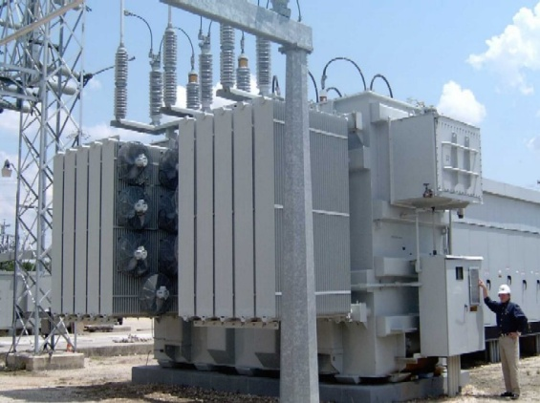
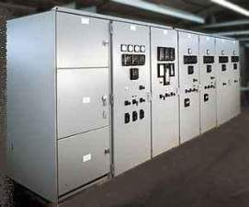
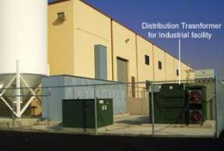
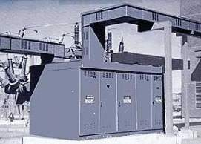
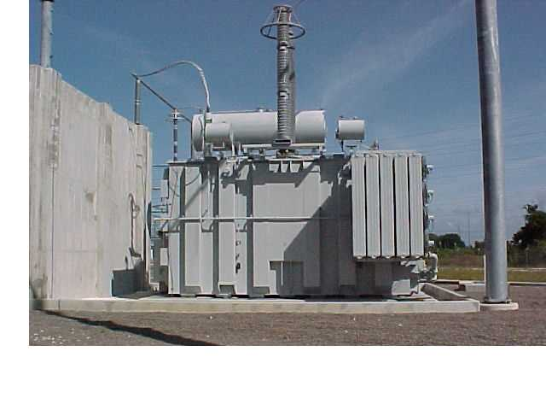
.
Questions ??

Slide 17
NEC Article 230.95 (C)
230.95 (C). Performance Testing. The ground-fault protection system shall be performance tested when first installed on site. This testing shall be conducted by a qualified person using a test process of primary current injection, in accordance with the instructions that shall be provided with the equipment. A written record of this testing shall be made and shall be available to the authority having jurisdiction.

Slide 18
NEC Article 110.14 (D)
110.14 (D). Installation. Where a tightening torque is indicated as a numeric value on equipment or in installation instructions provided by the manufacturer, a calibrated torque tool shall be used to achieve the indicated torque value, unless the equipment manufacturer has provided installation instructions for an alternative method of achieving the required torque.

